Slide 1

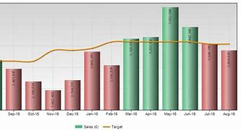
Trends, Graphs and Figures/Presenting Successfully at Work
Im
Lesson 2: 28/10/22
Trends, Graphs and Figures
Transitive and Intransitive Verbs
Adjectives and Adverbs of Movement
Exercises on Trends Graphs and Figures
Speaking Practice: In groups of 3, describe and explain graphs to class
Presenting Successfully at Work

Slide 2

Important Dates - Reminder
Im
Classes on 07/10, 28/10, 18/11 and 09/12
In Class graph description TP to be done in Week 3 (18/11/22)
Oral Presentation (TD) done in class in Week 4 in Groups of 3 (09/12/22)

Slide 3
Date | Lesson | Theme | Learning Outcomes/Objectives | Theme/Activities/Skills targeted | Resources
28/10/22 | 2 | Graphs, Trends and Figures | After completing this lesson students should be able to:- •describe graphs trends and figures using transitive, intransitive verbs. •describe graphs trends and figures using adjectives and adverbs of movement •Learn how to Successfully Present at Work • | Reading skills: Demonstrate understanding of how to read graphs using the right vocabulary. Speaking skills: Build and use vocabulary related to the theme and explain it to other students using the correct language. | Document on Trends, graphs and Figures. Exercise on graphs distributed in the previous lesson.

Slide 4
Graphs Trends and Figures
Using the document on Teams of the same title:- -Revise Graph Description (Dow Jones Index) -Use of Transitive and Intransitive Verbs -Use of Adjectives and Adverbs of Movement -Exercises

Slide 5
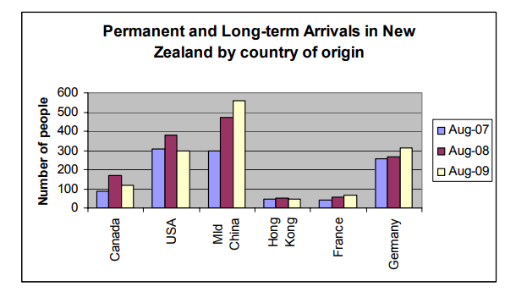
Students Describe Graphs in Groups of 3 Sample 1

Slide 6
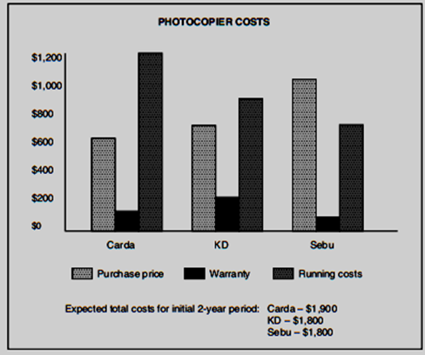
Sample 2

Slide 7
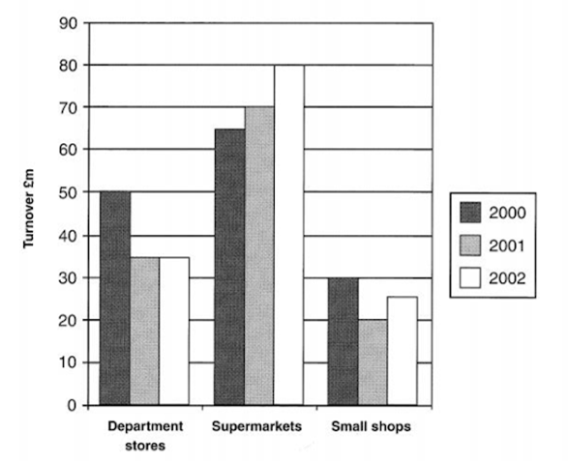
Sample 3

Slide 8
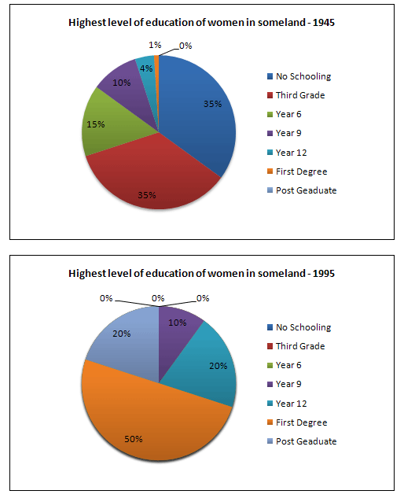
Sample 4

Slide 9
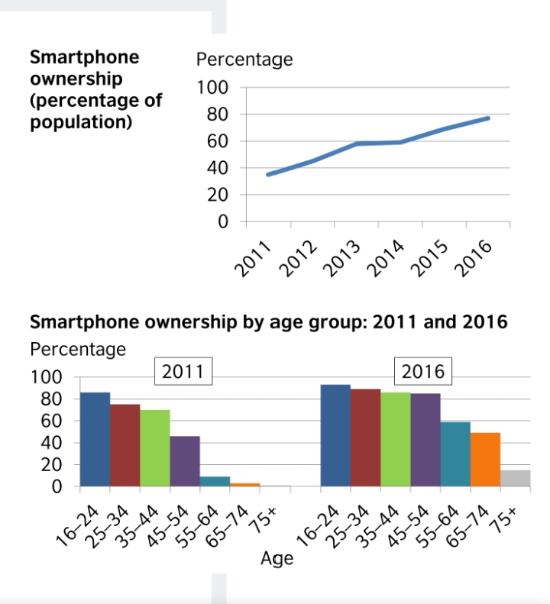
Sample 5

Slide 10
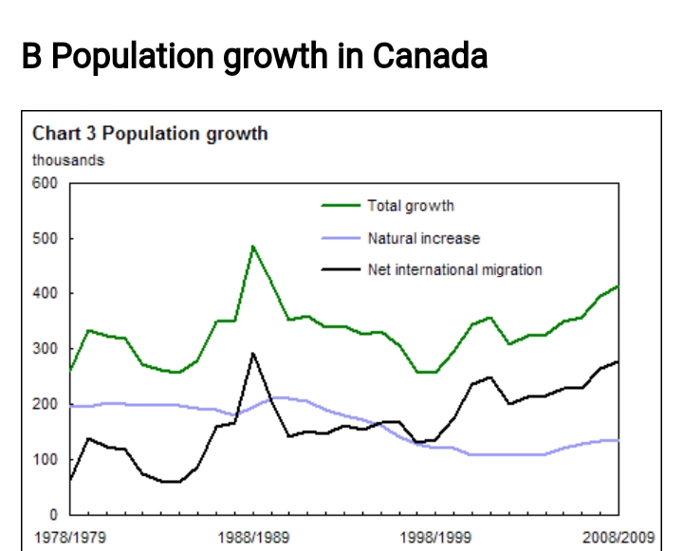
Sample 6

Slide 11

Coffee Break

Slide 12
Presenting at Work: Prepare Your Presentations in English 1. Know your Audience Who is your audience now? What do they know or not know? Where do you want them to be after the presentation? 2. Know Your Who and Your What What is your purpose? Generally, presentations are used to teach, to inform, to motivate. to persuade or to encourage action. When you understand the purpose of your presentation, it will be easier for you to use the correct language and the correct style. It will also help you organize your presentation well.

Slide 13
Presenting at Work: Prepare Your Presentations in English 3. Get Organised Presentations in English generally have 3 parts: Opening (Introduction) Body (Main Points and Details) Closing (Summary)

Slide 14
Presenting at Work: Prepare Your Presentations in English 4. Show Don’t Tell Have you ever listened to a presentation that has a LOT of numbers and statistics and data and dates? Do you remember any of that information now? Most people say no to that question. In English, the expression “show, don’t tell” means help your audience understand your main points through stories, visual aids and/or strong action words. People remember stories, not numbers. When you can, use a story or a great visual aid to help your audience remember your key points.

Slide 15
Presenting at Work: Prepare Your Presentations in English 5. Talk, Don’t Read For an audience, when someone reads a presentation it is boring and shows you didn’t prepare well. You can use note cards to help you remember and to stay focused. But talk to your audience. Look at your audience. Move around. Be comfortable and natural. Also, do not be afraid to go slow! A good presentation does not mean speaking fast. Remember: this is the first time your audience is hearing this information. They need time to hear and to think about what you are saying. You will help them (and you!) if you speak slowly. By speaking slowly, you will also have more time to think about what you want to say in your presentation, remember the key points and make fewer mistakes!

Slide 16

The End.
Thank you for your time

